Slide 1
SPSP Dentistry in Primary Care QI Collaborative
Irene Black

Slide 2


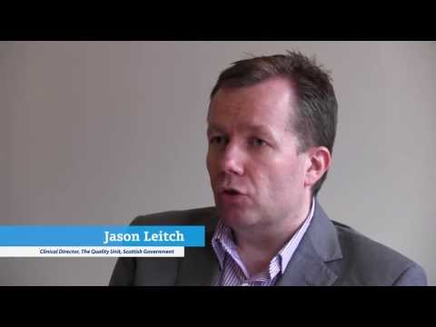

SPSP- QI and Patient Safety
Scotland Ahead of the Pack?
Aim
Safe,
Effective
Person Centred
Care
Ambition
To reduce the number of events which cause harm to people from healthcare delivered in any care setting.
Acute 2008-
1yr Care GMP 2011-
Pharmacy 2014
GDS 2016
Notes:
Not a phrase we often here as far as Scotland’s performance on the Sports field is concerned. But we do appear to be out there as far as patient safety and quality improvement in health care is concerned
Dental services have come a bit later to the table than other sectors I cant decide if that because we are so good already or perhaps because we were a little more difficult to tackle.The positive side to being late is that we can copy everyone else

Slide 3


Quality Improvement Tools in GDS
‘Quality Improvement Activity’ (New Term)
Now in Amended Regulations from October 17
Definition includes:
Audit
Peer Review
Enhanced SEA
Practice Based Research
Patient Safety Review
Must do 15 Hours/3yr cycle
Financial incentive available to dentists
Quality Improvement Methodology -NEW

Slide 4

Barriers to Quality Improvement for Dental ( and other) Teams
We are good enough already!
Another Burden
No time
Won’t work
No money
No motivation
No incentive
Real or perceived –
difficult to shift

Slide 5

Overarching Aim of the Dental Collaborative 2016-17
To Introduce QI improvement tools to GDS
based on
Institute of Healthcare (IHI)
Breakthrough Collaborative Series
http://www.ihi.org/resources/Pages/IHIWhitePapers/TheBreakthroughSeriesIHIsCollaborativeModelforAchievingBreakthroughImprovement.aspx

Slide 6
SPSP Dentistry in Primary Care Collaborative Timeline 2016
 | Jan – Mar | Apr – Jun | Jul – Sep | Oct – Dec
NHS board teams
National activities
Recruit dentistry teams and finalise intervention(s)
Start monthly data collection and
small tests of change (PDSA cycles)
Safety Climate Survey
Local learning sessions
20-21 Jan Induction event
16-17 Mar Learning Session 1
9 Nov Learning Session 2 (1 day)
Steering group meeting (approx 6 weekly)
Dates: 2 Mar, 4 May, 31 Aug, 12 Oct and 6 Dec 2016
Monthly data collection

Slide 7


Topics of Choice for Improvement in GDS
National Priorities ?
Year 2 Prevention of Periodontal Disease
Year 1 High Risk Medication
Anticoagulants
Antiplatelets
Bisphosphates
Updates and accuracy
Regular checking
Working with Pharmacies
Drug interactions
Poly pharmacy
Regular Screening
Providing OHI
Monitoring
Referring
Notes:
Along with this piece of work we work with outr streering gropu and the recurring them realed to patient medication
The number one recurring theme related to patient medication , medical histories . Polyphamacty and access to PMS

Slide 8

Year 2 Dental Collaborative
A Different Tack
Getting NES and VT practices on Board
Working together with HIS and NES
Different way to cascade QI methodology

Slide 9

Why Vocational Training Practices?
Young Enthusiastic Dentists
Practices set up to train and support
NES structure for communications
Advisers to lead
VDPS need to do ‘Audit’
Joint working with HIS NES and GDPs
Potential to evaluate and compare

Slide 10


National SPSP-PC Team (HIS)
NHS Fife
5 dental teams
NHS D&G
5 dental teams
NHS A&A
VDP
5 dental teams
12 teams EAST
Periodontal bundle
12 teams WEST
HRM MH bundle

Slide 11
HIS HBs and NES Provided;
Learning sessions
Background information on QI methodology
The aim and bundle questions with clear definitions
Data Collection spread sheet/ Excell or paper?
Instruction on collecting data
Instruction on submitting data
How to submit your QI application on Portal
Support and contacts
Incentives

Slide 12
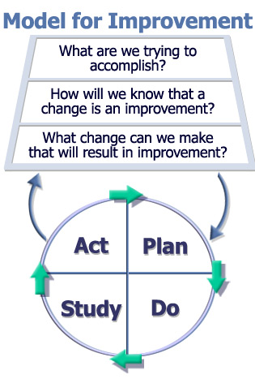
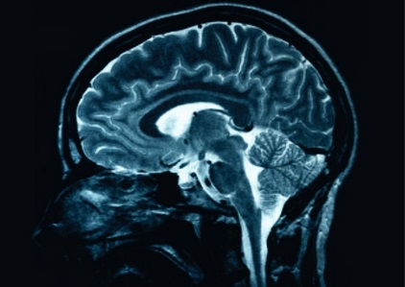

The Model for Improvement (MFI)
Aim
Measures
Changes
Testing
Notes:
QI tools
TOOL NUMBER 1
Main tool in break through series is MFI / model for improvement
So if we look first at the thinking part☺
The 3 questions – the thinking part prepares you for the test by asking the all important question ‘so what are we trying to accomplish’ ???
They need to be thought through, answered and written down by the improver to ensure that they, and therefore their colleagues, are clear on the benefits to them and their work.
That message often gets lost in the many things we are expected and asked to do and is one of the reasons why so many interventions are not implemented reliably.
BECAUSE If we are unclear on the benefits of something we are much less likely to do it.
The Plan Do Study Act cycle PDSA CYCLE is separate simple tool that’s used to test out ideas that will improve your systems and processes while learning what works and doesn’t work. But I’ll speak more about that later.
Together this AIMS tool and PDSA tool form the fundamental framework of the MIF.
MFI is made up of 2 parts – the thinking part and the doing part
The 3 questions – the thinking part prepares you for the test by asking the ‘so what’ question
They need to be thought through, answered and written down by the improver to ensure that they, and therefore their colleagues, are clear on the benefits to them and their work.
That message often gets lost in the many things we are expected and asked to do and is one of the reasons why so many interventions are not implemented reliably.
If we are not clear on the benefits of something we are much less likely to do it.
The Plan Do Study Act cycle is a simple tool that’s used to test out ideas that will improve your systems and processes while learning what works and doesn’t work.
It’s a structured approach for making small incremental changes to systems that allow you to test on a small scale, learn from successes and failure and redesign as you go
It builds learning and buy in incrementally as tests ramp up and allows clinicians knowledge about their own system is built in to the process

Slide 13

NOT the Same as Audit
Measurement for Improvement
Collect small samples frequently
It’s not the same as audit as we use it currently
It is about continuous measurement while thechanges are being applied rather than in two separate “before-and-after” chunks.
Create run charts and looks at trends

Slide 14


Aim Statements – how much by when?
AIM Content
  Explicit over arching description
  Specific actions or focus
  Goals
AIM Characteristics
  Measurable (How good?)
  Time specific (By when?)
  Define participants and customers
Notes:
Jill

Slide 15
Aim Statements
Periodontal Prevention
By 31 March 2018, 85% of registered adult patients presenting for a routine examination, will have a preventative personal care plan communicated to them."
High Risk Medications
‘By December 2016, the collaborative will achieve 90% compliance with the high risk medications care bundle’.
Notes:
These were the aim statesments developed year one and year 2 of the collaborative this is what the practices were trying to do

Slide 16

Planning the Project
Improvement mean things need to change
You need to understand the system fully to know what you can change
Tools used to plan for change;
Driver diagrams
Fish bone diagrams
Theory of profound knowledge
Force field analysis
Changes should make it easier to do the right thing every time for patients and the dental team
Notes:
At risk of stating the obvious but if you have an aim and you are trying to improve something this is going to involve change

Slide 17


The Crux of the Matter Measurement is key
PREDICT

Slide 18
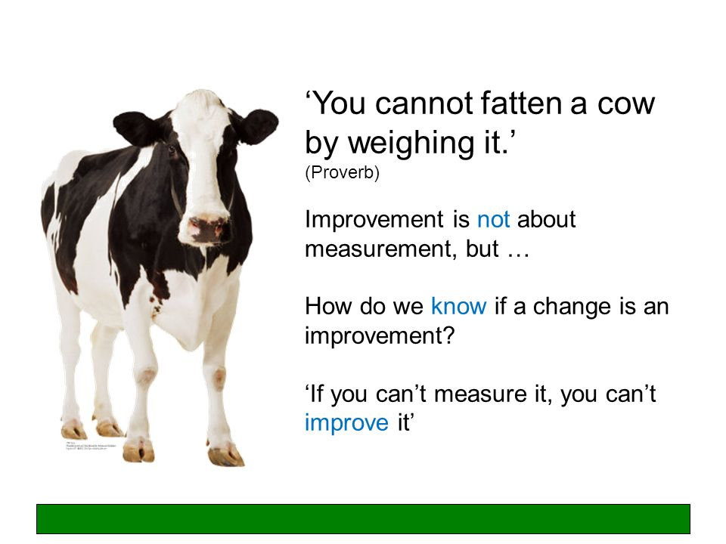

Slide 19

One way to measure -Care Bundles
Learning to choose the right question!!!
Notes:
IRENE

Slide 20
High Risk Medication Care Bundle
Does the patient have an updated medical history completed at the beginning of their most recent course of treatment?
Was the patient risk assessed in relation to medication and proposed treatment plan in accordance with national/local guidance?
Are arrangements in place for an appropriate appointment in relation to medical history risk management?
Is there documented evidence that the patient has been made aware of the potential impact of medical condition on their dental care?
Is there a relevant alert/flag on the patient records to identify their risk?
Notes:
Content slide option 3

Slide 21
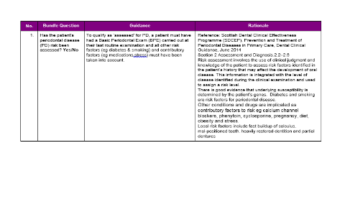
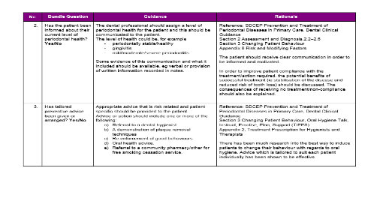
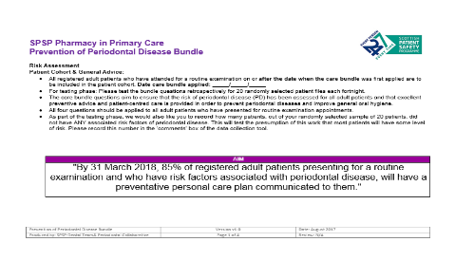
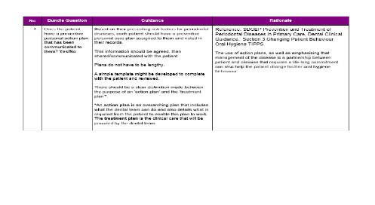
The Prevention of Periodontal Disease Care Bundle questions
1) Has the patient’s risk of Periodontal Disease been assessed?
2) Has the patient been informed about their current level of Periodontal health?
3) Has tailored preventative advice been given or arranged?
4) Does the patient have a preventative personal care plan that has been communicated to them?
Notes:
ALEC/IRENE
Hand out guidance and rationale for discussion

Slide 22
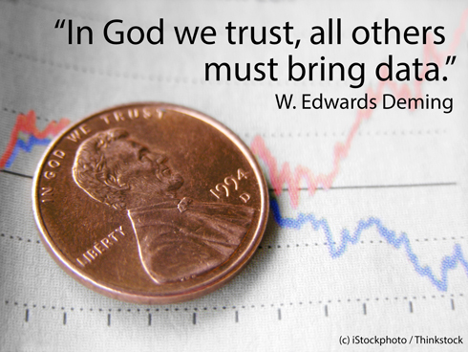
DATA – Not everyone’s favourite

Slide 23

Improvement isn’t about data so why do we need it ?
If you don’t know where you are how do you know where you need to go?
How can you evidence that you are trying to improve?
How do you know if you’ve changed something and if it has worked?
If it worked, is it a sustained improvement?
Becomes embedded in process
Stretch to improve

Slide 24
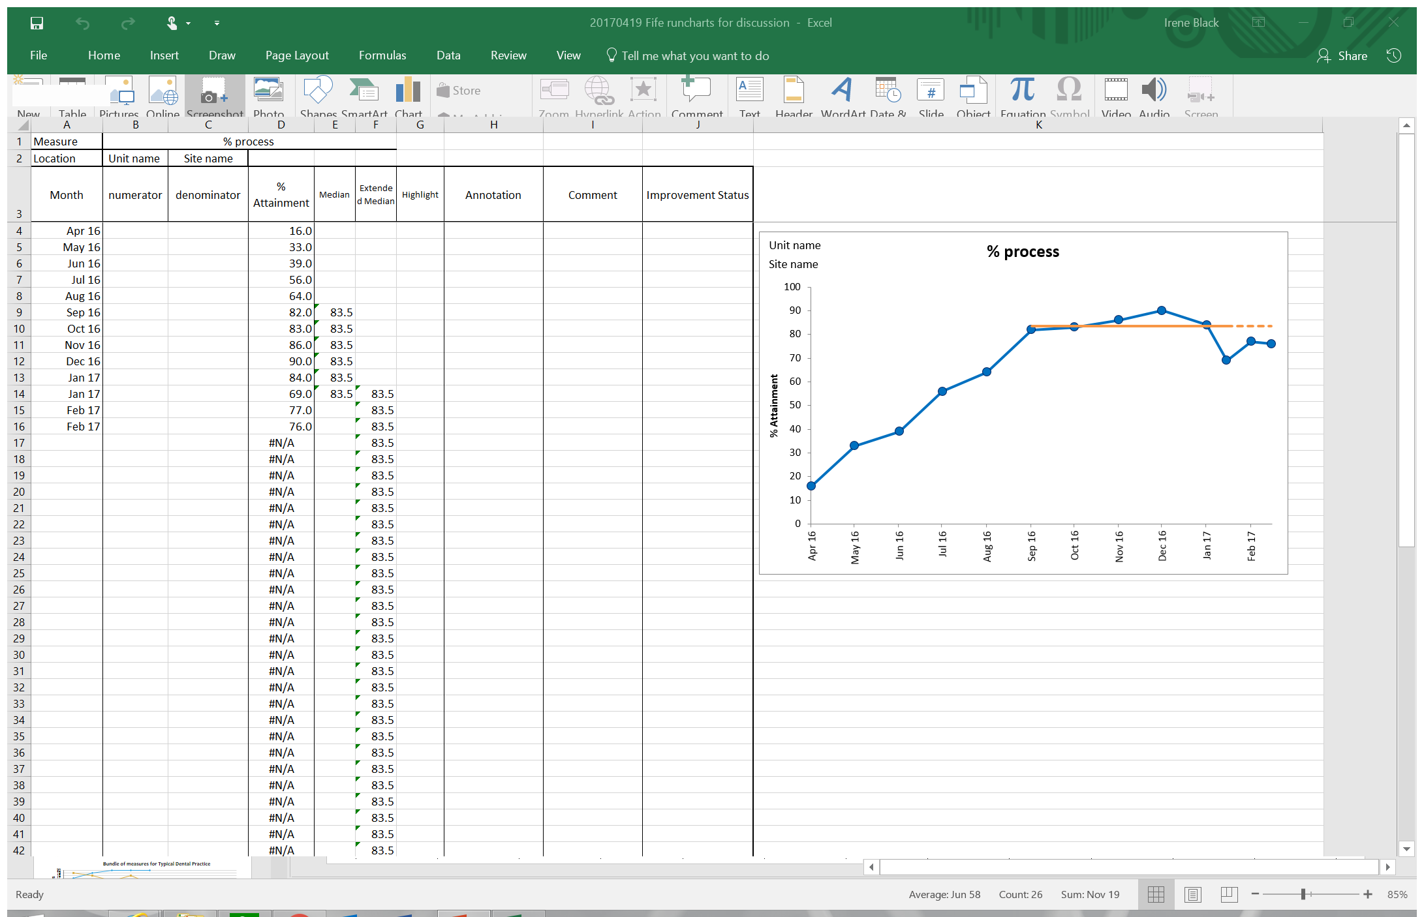
Data Collection Numbers and Run Charts -Excel is your friend!

Slide 25
Data Collection
Small regular sampling
1) Pick 20 random patient files each fortnight
2) Apply the bundle questions
3) Enter results in the excel document
4) Send the excel document at the end of each month to HIS
5) Review your results with your team
6) “tests of change” (PDSA record)
Notes:
ALEC
So…. This is the process, “the ask” ….same as before, just different bundle questions

Slide 26

Tests Of Change- the best bit.
Doing
Opportunity for innovation and imagination
Need ideas from the whole team - Listen to everyone
Changes should make it easier to do the right thing every time
Try something -if it isn’t working ditch it and try something
else
Notes:
Systems – processes & outcomes
Using small tests of change – incremental improvements towards the aim – can we define them & plan them?
Benefits of testing – reduces resistance, reduces risk, increases belief that the change will work.
Did the changes lead to improvement?
What learning came from failed tests?

Slide 27

PDSA
What changes are to be made?
Next cycle?
Aim and plan the cycle (who, what, when and how)
Compare/analyse data
Summarise learning
Carry out the plan
Document results
PDSA Plan Do Study Act
Notes:
Content slide option 3

Slide 28
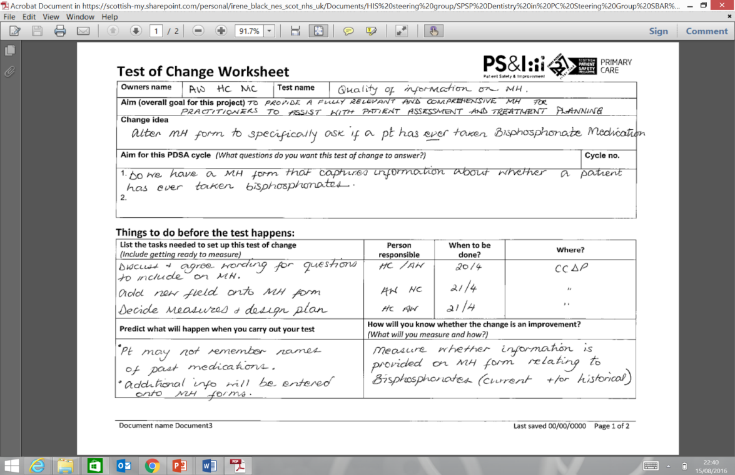
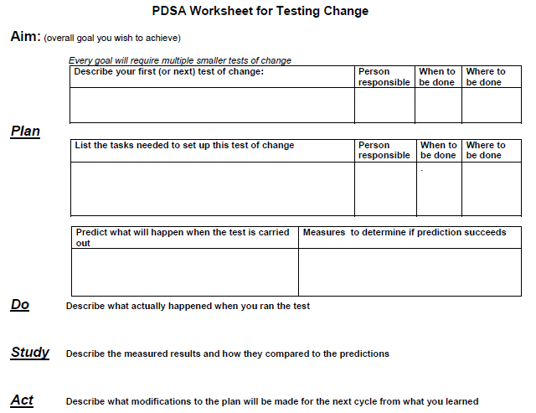
PDSA Record

Slide 29
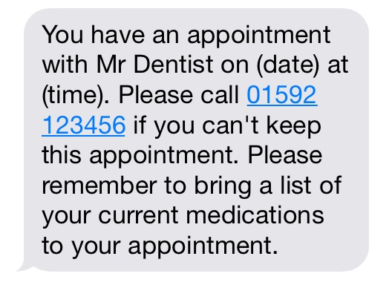
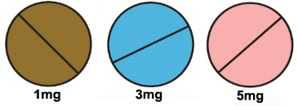

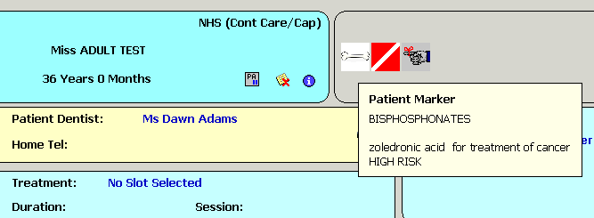
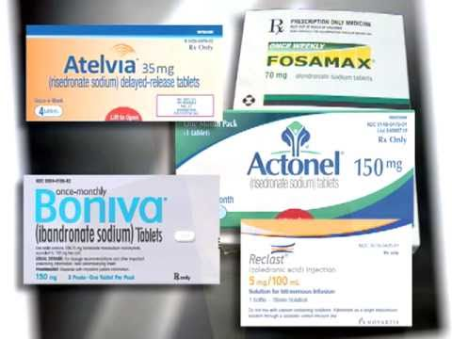
Tests of Change
A poster was created for the waiting room to include photographs and names of high risk medication examples.
Warfarin Tablets
Metformin Tablets
or Insulin Injections
Bisphosphonate drugs for
your Bones

Slide 30
What Did Dental Teams Say?
The team had great ideas that the dentists had not considered
The SPSP approach has introduced the quality improvement methodology into the dental team.
PDSA has helped create a safer environment, resulting in a more reliable process, reducing variation through greater engagement of both the patient and the dental team in primary dental care.
Team more confident raising ideas, concerns or issues
We were concerned it would be seen as ‘another thing to add to the to do list’ but total opposite- desperate to make changes

Slide 31
The Results
Test version
Notes:
And the same principle used in all developments

Slide 32
Results
Notes:
Pilot sites have highlighted that the greatest opportunity for improvement in their practice is the ‘communication of a patient’s personal preventative care plan’. There is an opportunity and evidence for a cultural shift as participating practices now focus their attention on interventions to address this patient centred improvement and begin to change their practice to accommodate this.
Examples of test of change include:
A printed patient information leaflet that doubles a checklist reminder and ‘contract’ between the patient and the dental professional on things they can do to improve their oral health
Individually selected short videos on oral health advice being attached to patients SMS appointment reminder text and e-mailed treatment plans
The addition of a checklist added to software systems at either examination, scaling or hygienist appointments.
As both groups have highlighted the communication of preventative advice as a need for improvement, and there is a willingness within the profession to address this, this would become a focus in the next phase of this pilot work.

Slide 33
What Did We learn from the QI experience
QI methodology was new and challenging for dental teams.
Needs underpinning knowledge and practical application with dental examples earlier. EDUCATION +++
The question is critical –need to be able to be measured to collect data
Need better IT systems and skills
Whole team involvement is critical
Need access to support
Need leadership and motivators
Need to improve communication between practices and other services
Notes:
IRENE

Slide 34

The Patient’s Perspective …..

Slide 35

Thank you
Twitter: @ihubscot #spsp10
Email: info@ihub.scot
Web: ihub.scot/spsp

