Slide 1

The Role of the Oral Dental Specialty Group
          Mary McAuley & Sarah Kennedy
          NRS Portfolio Performance Managers

Slide 2

Who are we ?
The Oral and Dental SG is split between two NHS Boards
NHS Tayside & NHS Greater Glasgow & Clyde
SG Clinical Leads
Professor David Conway & Professor Jan Clarkson
SG Managers: Mary McAuley & Sarah Kennedy
SG Administrator : Jill Strachan (Tayside)
Notes:
Speciality Group is lead by a part time Clinical Lead – normally as NHS Consultant or equivalent and hosted by a Scottish Health Board. The Oral Dental Portfolio is split across 2 NHS Boards.
SG Managers – are hosted in a NHS Greater Glasgow & Clyde & NHS Tayside R&D Department reporting via R&D Systems Manager.
SG Administrator is hosted in NHS Tayside

Slide 3

NRS Oral Dental Specialty Group Portfolio
Overall Aim
Provide managerial support at national level to oversee and proactively drive recruitment to time and target for research projects within NHS Scotland working with participating NHS Boards.
Notes:
Combination approaches to address recruitment :
Generate performance reports.
National overview of portfolio with SG Leads to identify issues raised and onward communication with local R&D Board department via Performance Managers / PI’s to highlight study is not reaching it’s recruitment targets as anticipated
25% of role is to provide management support to hosted Scottish SG Clinical Lead to assess eligible funded studies overall study performance and recruitment.
Manage studies underperforming recruitment nationally to time and target which are led from Scotland and from other nations which Scottish sites are participating in.
Broaden participation of local researchers across Scotland for the portfolio working with SG Leads and Boards

Slide 4
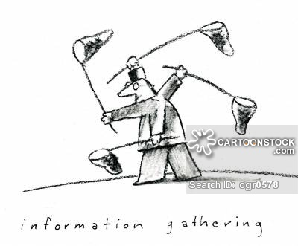
How do we monitor and measure performance?
Data Capturing using
SReDA – Scottish Research Database
CPMS – Central Portfolio Management System
Report Generation using
National NRS Metrics (same as NIHR metrics)
NHS R&D Board Liaison
Communication with other R&D NHS Boards to follow up on recruitment activity and enquires
Monitoring Performance
Based on recruitment and number of studies
actively recruiting within each year
Notes:
Commercial and Non commercial
25% of role is to provide management support to hosted Scottish SG Clinical Lead to assess eligible funded studies overall study performance and recruitment.
Manage studies underperforming recruitment nationally to time and target which are led from Scotland and from other nations which Scottish sites are participating in.
Broaden participation of local researchers across Scotland for the portfolio working with SG Leads and Boards

Slide 5
Recruitment to Time and Target Metrics
RAG
Above 0% | GREEN
Between 0 and 15% Behind Target | HACTCHED GREEN
Between 15 and 30% Behind Target | AMBER
More than 30% Behind Target | RED
“How far behind are we compared to where we should be?”
=

Slide 6
Oral Dental Portfolio –Active studies
Short Title | Health Board
The Immune Response after Periodontal Treatment (IRaPT) | NHS GGC
Microbiota and host immune response in pathogenesis of oral diseases | NHS Grampian
The Immune Response in Periodontal Disease | NHS GGC
Orthodontic reduction of increased overbite | NHS Tayside
GDOC Study | NHS GGC
BRIGHT Trial | NHS Tayside
Calcivis System - Orthodontic Caries Lesion Activity Behaviour | NHS Lothian
Validation of the Calcivis System® for dental caries activity assessment | NHS Lothian
Notes:
Top 5 are non-commercial, bottom 2 are commemrcial
Active studies- studies which have been issued R&D approval. Studies where recruitment has finished, and patients are in follow up are not considered part of the portfolio for the purposes of performace management
Primarily portfolio is studies led from Scotland.
Commercial and Non commercial
25% of role is to provide management support to hosted Scottish SG Clinical Lead to assess eligible funded studies overall study performance and recruitment.
Manage studies underperforming recruitment nationally to time and target which are led from Scotland and from other nations which Scottish sites are participating in.
Broaden participation of local researchers across Scotland for the portfolio working with SG Leads and Boards

Slide 7
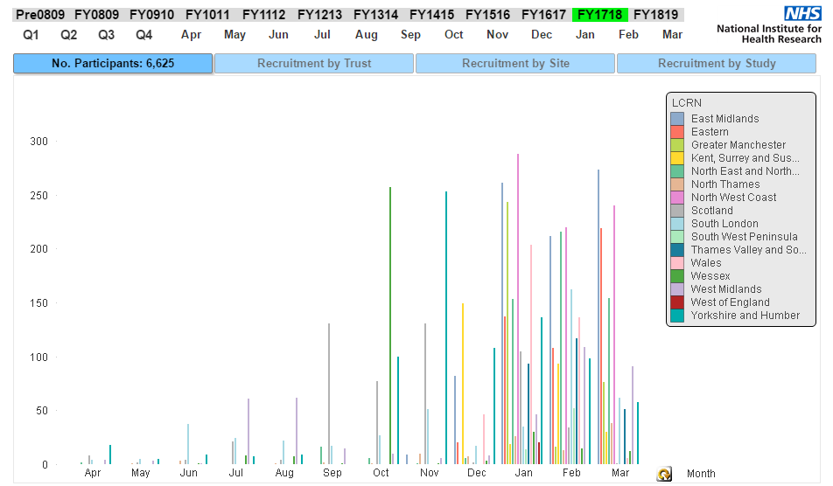
Performance Reports – using CPMS data
Notes:
Allows comparison with performance in England
By year, by site, by study

Slide 8
Why measure SG Portfolio Performance?
Portfolio Performance reports provide a benchmark to monitor participant recruitment for Specialty Group (10% of the corresponding English specialty).
Recruitment is credited to study portfolio where the research recruits in the specialty.
Allows opportunity for maximising the number of studies being opened each year in the portfolio.
Identifies specific problems with recruitment which may be dependant on differences across NHS Boards.
Creates opportunity for collaboration.
Increases revenue for research infrastructure.

Slide 9

Summary
Oral Dental Portfolio Team
Provides Clinical Research Leadership.
Unique system of support for research in the NHS.
Opportunity to have a pan Scotland approach to maximise opening sites.
Close scrutiny of recruitment activity to time and target.

Slide 10
Into the future
Building Capacity
Increase research projects for the portfolio
Increase number of research active clinicians
Increase Scottish collaborations between NHS Boards, Universities and Industry partners.
Growth and Clinical Impact
Broaden research and disease range in portfolio
Develop KPIs for portfolio
Notes:
Key performance indicators
For 2018-19 target of each SG providing input to Board annual report on projects with high research impact

Slide 11
Thank you
Portfolio Manager Contact Details
mary.mcauley2@ggc.scot.nhs.uk
sarah.kennedy17@nhs.net
Administrator
jillianstrachan@nhs.net

