Slide 1


A QI Training experience
- CT Perspective
Vinay Mistry
Dental Core trainee 3 in quality improvement and clinical practice
SDPBRN POSTGRADUATE TRAINING DAY
thursday 21st june 2018

Slide 2

outline
What is QI?
About me
What is CTQI?
Clinical Practice
Projects
PGCert in QI
Other parts of my role
Final thoughts

Slide 3
What is qi?

Slide 4


Slide 5


Slide 6


Slide 7



ABOUT ME
Haworth is home!
BChD at University of Leeds (2014)
LDFT in Wakefield & Huddersfield:
  Practice – DFT
  Hospital – OMFS, Oral Surgery, Orthodontics
  Community – Paediatric & Special Care Dentistry
DCT2 in York – OMFS
DCT3 in Dundee – QI & Clinical Practice

Slide 8
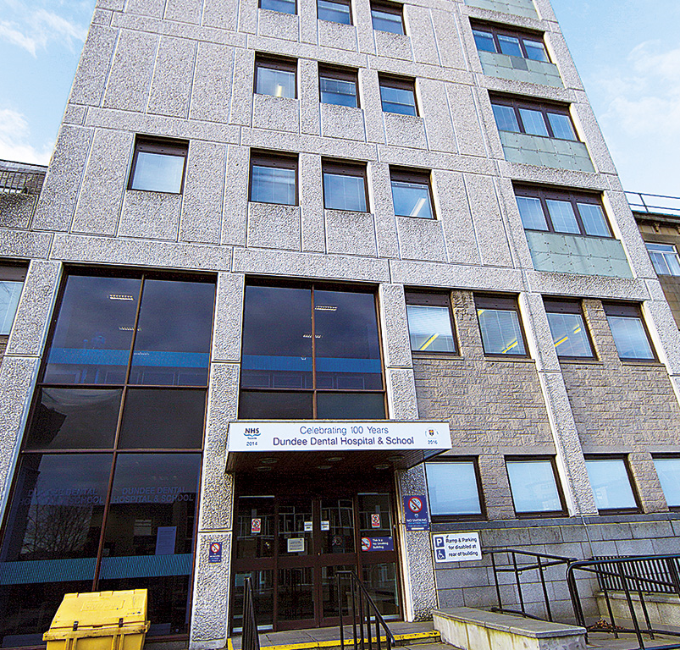



What is ctqi?
Core Trainee in Quality Improvement
50:50 split
Clinical commitment at DDH&S
NES Clinical Effectiveness workstream:
  TRiaDS
  SDCEP
  SDPBRN
QI and research
Translation into clinical practice
I chose this because…

Slide 9
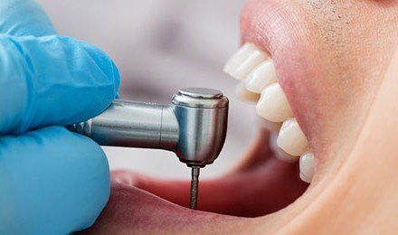
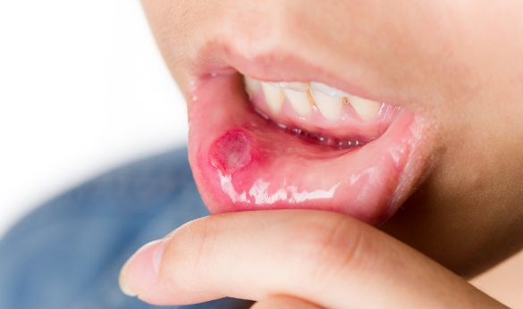

clinical practice
Restorative Dentistry:
Endodontics
Conservative Dentistry
Periodontics
Prosthodontics
Oral Medicine:
Outpatient clinics
Teaching 4th & 5th year dental students
Oral Surgery:
Teaching 3rd year dental students:
  LA
  Extractions

Slide 10

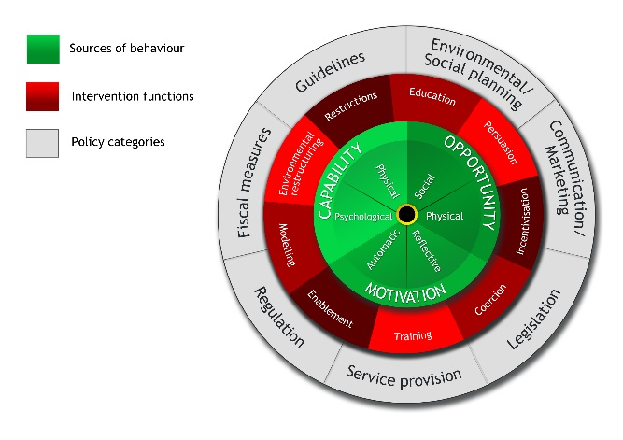
PROJECTS
Clinical Effectiveness Projects:
SPSP Primary Care in Dentistry Evaluation
  Qualitative study
  General practice
  Whole dental team
  Focus on improving patient safety
  QI Care bundles (x2)
Challenges:
  TDF & Behaviour Change Wheel
  Data analysis – SPSS
What I’ve learnt:
  Interview/study schedule
  TDF questions

Slide 11
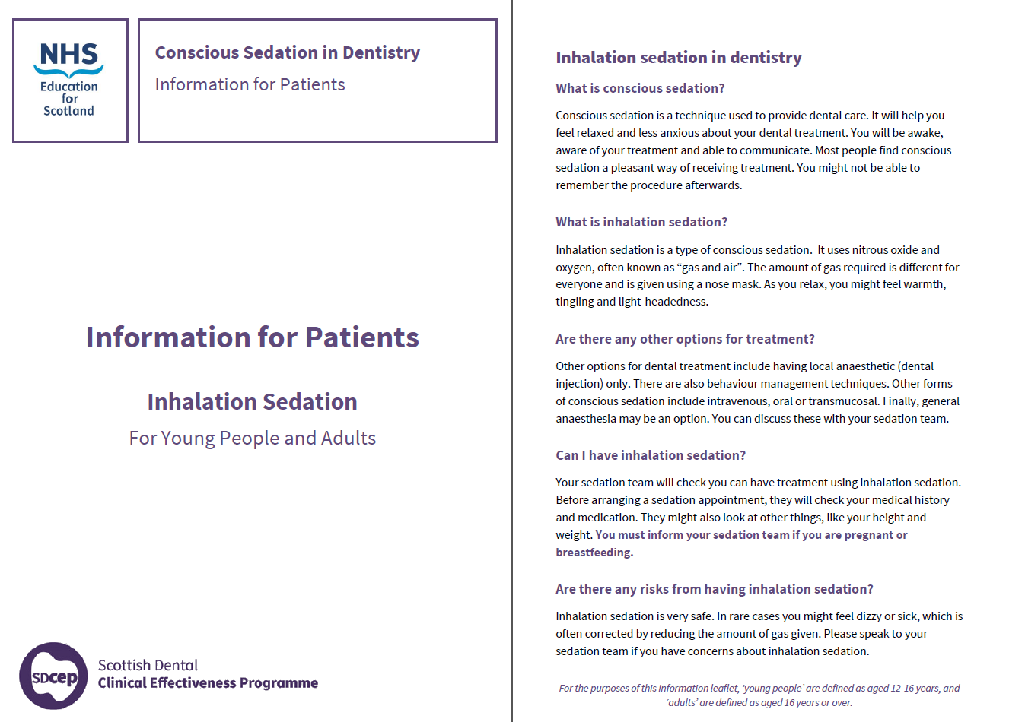
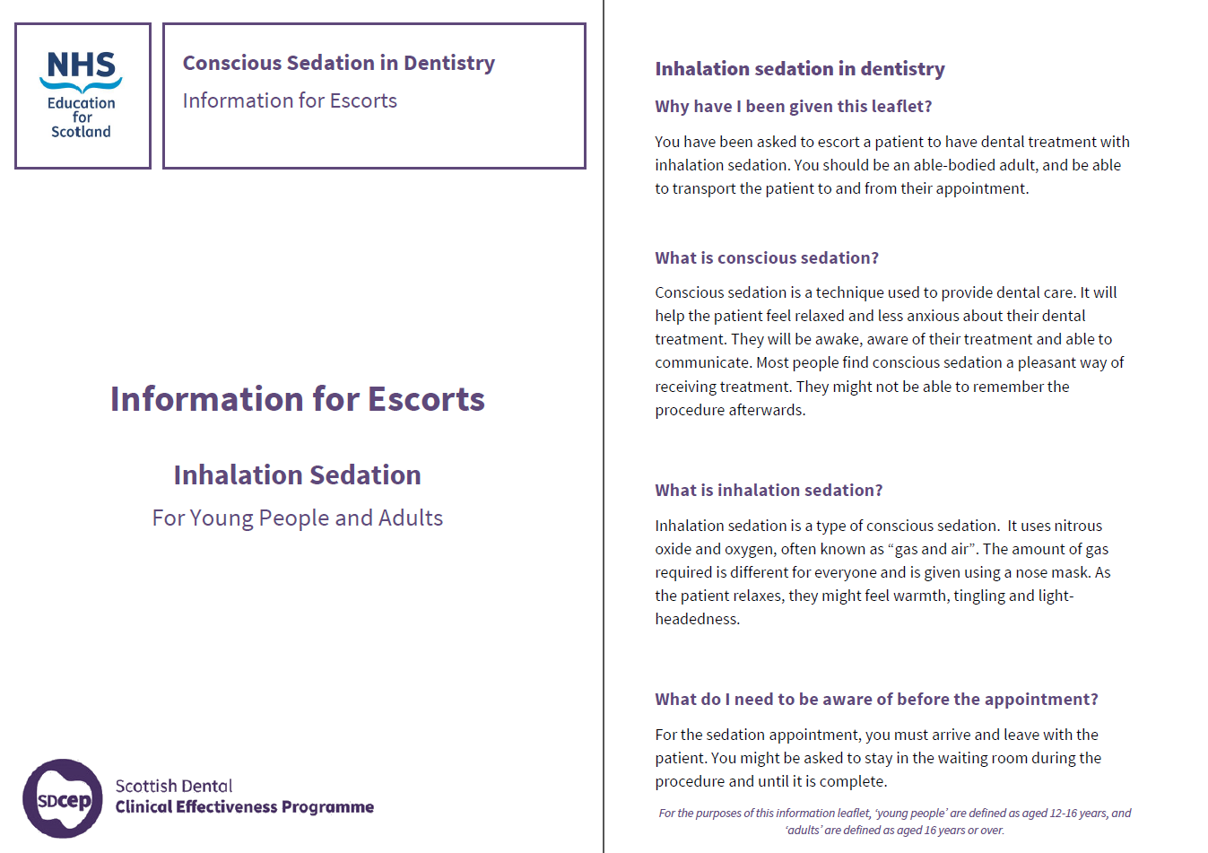
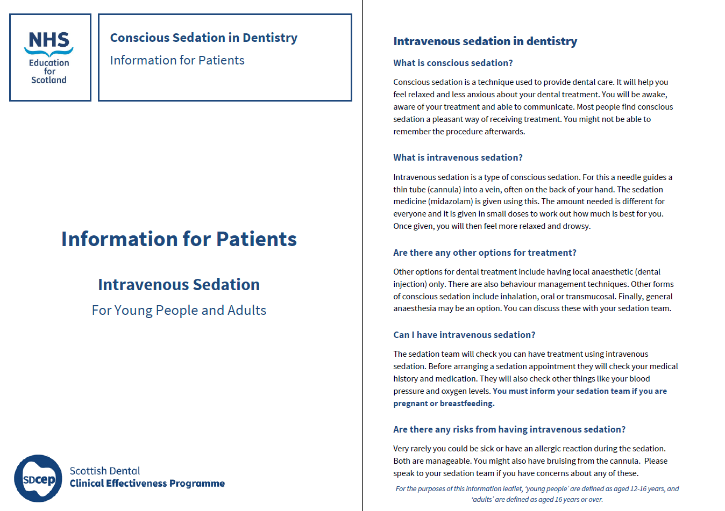
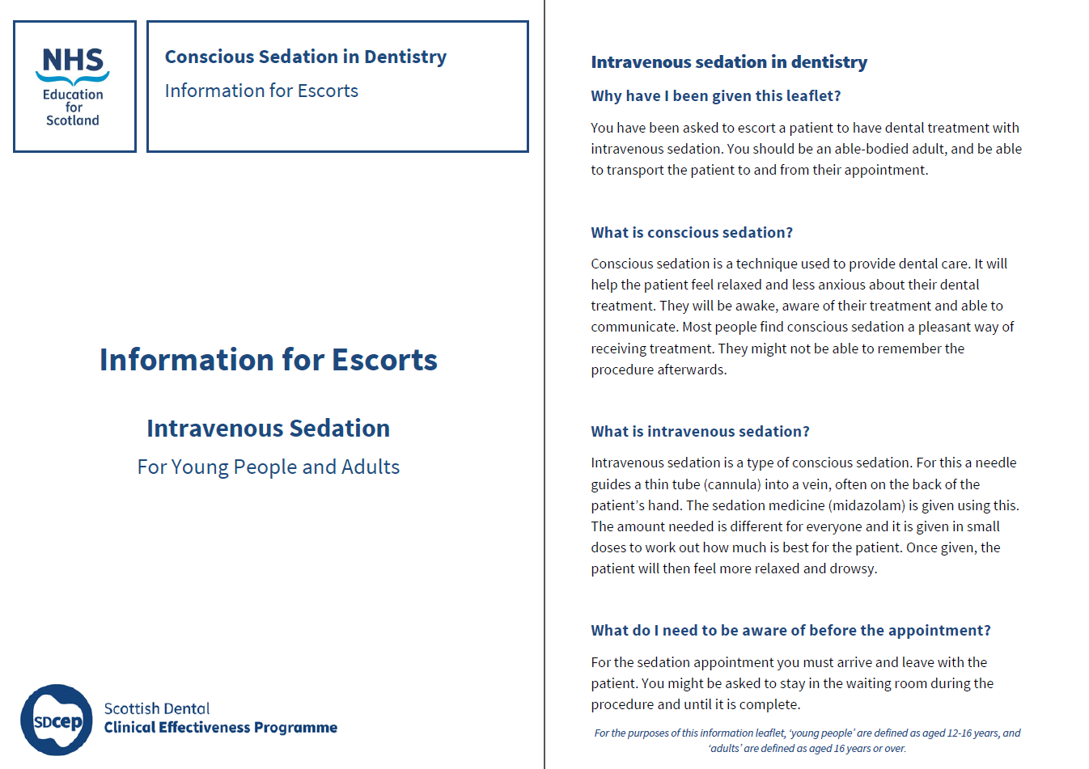
PROJECTS
Clinical Effectiveness Projects:
SDCEP Conscious Sedation Information Leaflets (x4)
  Based on SDCEP guidance
  IV & Inhalation Sedation
  Patient & Escort
  3 stages
Challenges:
  Guidance compliance – SDCEP
  Branding compliance – NES
  Patient feedback
What I’ve learnt:
  Feedback for positive change

Slide 12
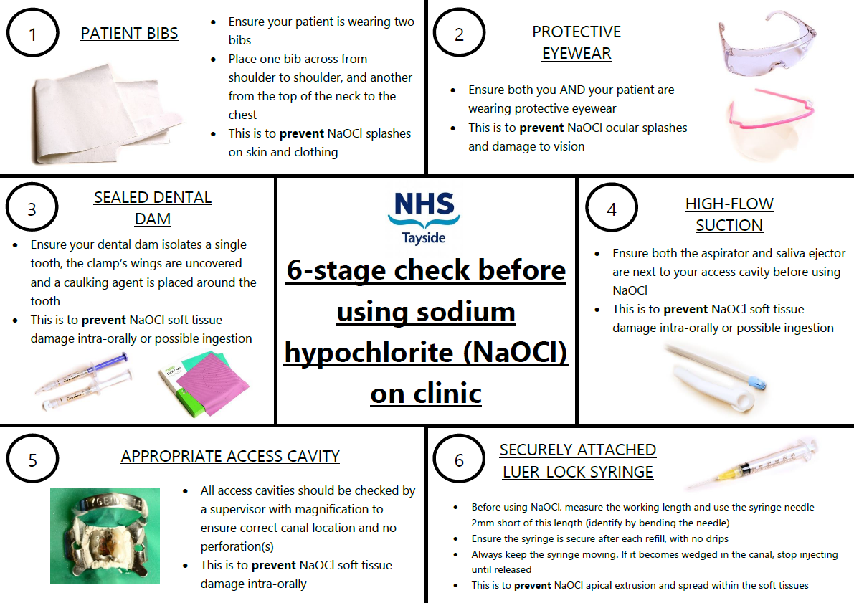
PROJECTS
DDH&S QI Projects:
Prevention and management of sodium hypochlorite injury on clinic
  Project charter
  Model for Improvement
  Driver diagram
  Poster/protocol
Challenges:
  Evidence base
  Management protocol
What I’ve learnt:
  Implement a QIP

Slide 13


PGCert in qi
University of Dundee
Separate to CTQI
Distance/blended learning
Self-directed
First year of 3-year MSc
30 credit modules:
  QI in Action
  Leadership
Assessment – 4500-word essay per module
  Measuring Quality
  Quality & Clinical Governance

Slide 14
Other PARTS OF MY role
DDH&S Clinical Governance secretary
QI rep for DDH&S Safety, Clinical Governance and Risk Committee
DCT Journal Club
Wikipedia Projects with undergraduates
Evidence-Based Dentistry

Slide 15

Final thoughts
Challenging, unique post
… And very rewarding!
Patience of others
Take the opportunities given

