Slide 1
SDPBRN Postgraduate Training Day
Using Statistics
Dundee Dental Education Centre
2nd March 2018

Slide 2

Show of Hands
Are you or do you plan to do a study involving statistical analysis of data?
What type of data are you collecting?
Have you or do you intend to plan your statistical approach before collecting your data?
Photo: Brian Marks

Slide 3
Today
Types of data
Descriptive statistics
Hypotheses, errors and significance
Types of statistical tests

Slide 4
Types of Data
Determines appropriate statistical descriptions and tests
Nominal
  categorical variables with no inherent order or ranking (=, ≠)
Ordinal
  variables with an inherent rank or order (<, >)
Interval
  variables are ordered and the difference between them is meaningful (+, -)
Ratio
  as interval data with a non-arbitrary zero point (+, -, x, ÷)

Slide 5
Descriptive Statistics
Provide a summary / overview of the data and does not try to explain or interpret.
Population parameters; Sample statistics
Descriptive Measures
Frequency count, percentage, frequency use to show how often a response is given | Central Tendency mean, median, mode use to show an average or most commonly indicated response
Dispersion/Variation range, variance, standard deviation use to find out how spread out your data are | Position percentiles, quartiles how scores fall in relation to one another

Slide 6
Inferential Statistics
Using sample data to make predictions (inferences) about the whole population
  testing hypotheses, measuring associations, predicting outcomes
Samples can be
  random (simple, stratified, cluster, systematic)
  non-random
Sampling error – (population parameter minus sample statistic)
  not representative of the population
  not large enough

Slide 7
Generating hypotheses
Example
Two groups of smokers randomly allocated to receive NRT (Gp. A) or not (Gp. B) for stopping smoking
Outcome - CO₂ breath test
H₀ Null hypothesis of no difference
H₀ No difference between proportion of people giving up smoking in the two groups
H_{A} Alternative hypothesis of a difference
H_{A} Difference between proportions of people giving up in the two groups (2 sided)
H_{A} The proportion of people giving up in group A is greater than those in group B (1 sided)

Slide 8
Testing hypotheses
Assume null hypothesis true
On basis of data either reject or fail to reject the null hypothesis in favour of the alternative hypothesis
Example
H₀ No difference between Gp. A and Gp. B
  fail to reject H₀ in favour of H_{A}
H_{A} Difference between Gp. A and Gp. B (2 sided)
  reject H₀ in favour of H_{A}
H_{A} Proportion stopping smoking in Gp. A is greater than the proportion in Gp. B (1 sided)
  reject H₀ in favour of H_{A}

Slide 9
Probability
The probability of getting an event (e.g. a head when a coin is tossed) is the proportion of times this event will occur in a long series of random trials (coin tosses)
Ranges from 0 to 1 and measures the degree of belief in a hypothesis or statement

Slide 10
Types of error
A type I error is the error of wrongly rejecting Ho when it is true. The probability of making a type I error is denoted by α.
A type II error is the error of wrongly accepting Ho when it is false. The probability of making a type II error is denoted by β. I - β is the power of a statistical test

Slide 11
Significance level
The level of significance is defined as the probability of making a type I error, and therefore equals to α
Usually the level of statistical significance is stated by the P-value
P values less than 0.05 (expressed as P<0.05) considered "statistically significant" and P values less than 0.01 (P<0.01) considered "statistically highly significant."
Statistical significance and clinical importance

Slide 12
Confidence Intervals
The Wobble Factor
How sure are we about the results?
The range within which the true size of the effect (never exactly known) lies, with a given degree of assurance (95% or 99%)
No effect
The shorter the confidence interval the more certain we are about the results
If it crosses the line of no treatment effect the intervention might not be doing any good and could be doing harm

Slide 13
Common Statistical Tests
Testing differences between groups Parametric tests – continuous data, normal distribution, equal variance
Independent sample t-test | Compares the means of 2 independent groups
Paired t-test | Compares two repeated means from the same groups
One-way ANOVA | Compares the means of > 2 independent groups

Slide 14
Testing differences between groups Non-parametric tests –data at least ordinal distributions are similar in shape
Mann-Whitney U | Non-parametric equivalent of independent samples t-test
Wilcoxon sign-rank test | Non-parametric equivalent of paired sample t-test
Kruskal-Wallis test | Non-parametric equivalent of one-way ANOVA
Testing differences between groups – nominal data
Chi-square | Tests for differences between 2 or more nominal variables (2x2 tables test difference)
In general parametric tests are
more powerful than non-parametric tests
easier to interpret

Slide 15
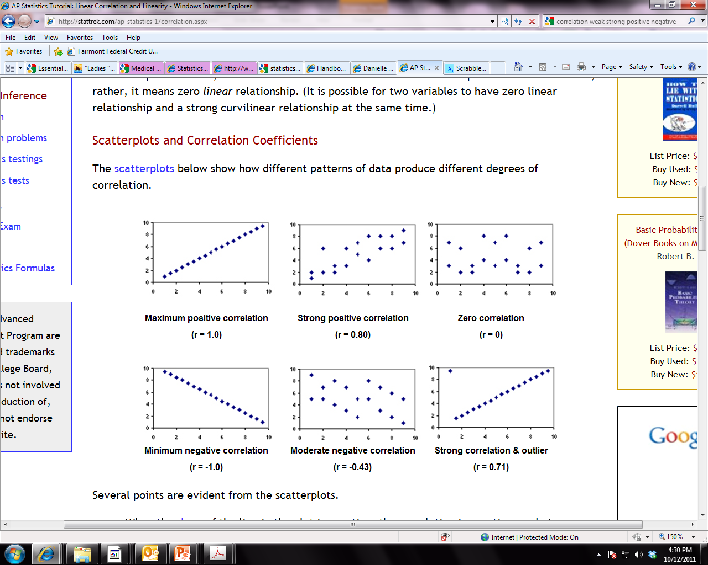
Measuring association between variables
Pearson correlation (r) | Tests for the strength of a linear association between 2 continuous (interval/ratio) variables e.g. height and weight
Spearman correlation (rho) | Tests for the strength of a linear association between 2 ordinal variables e.g. job satisfaction and motivation to improve skills
If r is negative, low values of one variable are associated with high values of the other variable
If r is positive, high values of one variable are associated with high values of the other variable

Slide 16
Estimating the relationship between an outcome variable and an explanatory variable
Simple regression | Single explanatory variable - Predicts how the value of an outcome variable changes when the explanatory variable is varied
Y= α + Βx + e | Y = dmft; X = age; β = change in Y if X changes by one unit
Multiple regression | Multiple explanatory variables – Predicts how the value of an outcome variable changes when an explanatory variable is varied holding all other explanatory variables constant
Y= α + β₁X₁ + β₂X₂ + β₃X₃ + e | Y = dmft; X₁ = age; X₂ = sugar consumption; X₃ = SIMD quintile β₁ = change in Y if X₁ changes by one unit holding the values of X₂ and X₃ constant

Slide 17
Research Question | Information and data type | Test
Do adults who attend the dentist regularly experience less dental anxiety?
Do patients who brush with fluoride toothpaste have more sound teeth?
Are there differences in the average yearly incomes of dentists, medics and vets?
How does life expectancy decrease for every additional pound overweight and for every X cigarettes smoked per day?
Is there a difference between the percentage of men and women who use tooth whitening products?

Slide 18
Summary
Plan your statistical approach before collecting data
The type of data you collect determines appropriate statistical descriptions and tests
Descriptive statistics can be used with nominal, ordinal, interval and ratio data = describe the sample
Inferential statistics can be used test hypotheses, measure associations, predict outcomes
Inferential statistics tell us the statistical significant of our findings and if we can infer from our sample to the larger population

