Slide 1

Critical Appraisal
Dr Samantha Rutherford
Research and Development Manager

Slide 2
Evidence-based dentistry
Evidence–based dentistry requires the integration of:
  systematic assessments of clinically relevant scientific evidence, relating to the patient’s oral and medical condition and history,
  with
  the dentist’s clinical expertise and
  the patient’s treatment needs and preferences

Slide 3
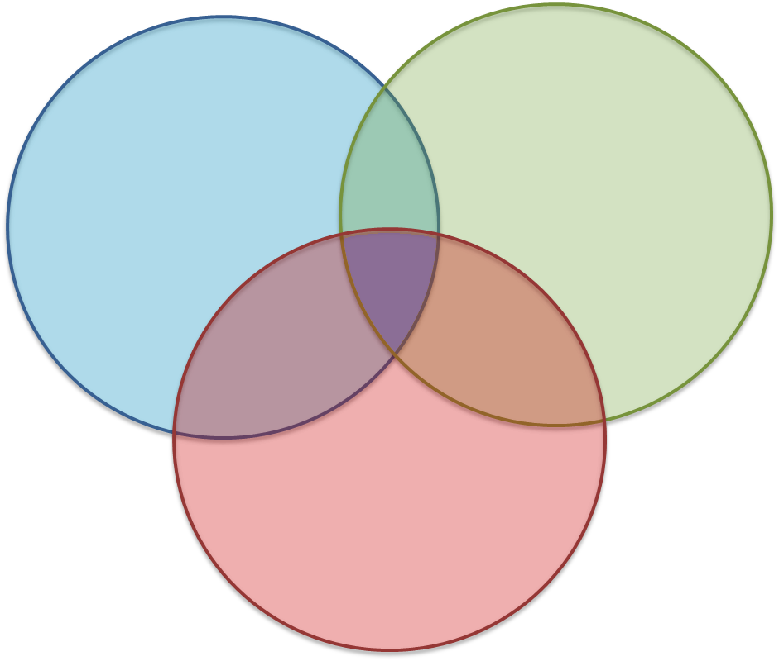
Evidence-based practice
Best Evidence
Clinical Experience
Evidence-based
practice
Patient Values

Slide 4

How should research evidence contribute to dental care?
effective care identified
Primary
Research
Critical
Appraisal
Systematic
Reviews
Research
Researchers, Policy Makers
15 years
Dissemination
Education
effective
dissemination
Professional
Organisations
Implementation
Use by
Clinicians
Informed
Patients
effective implementation

Slide 5
Evidence in dentistry
Continual production
  >900 dental journals in print
  Every month sees publication of
    2000 dental or oral health articles
    150 RCTs
    3 new practice guidelines
Lack of evidence from primary care
Change of practice required for patient to benefit

Slide 6
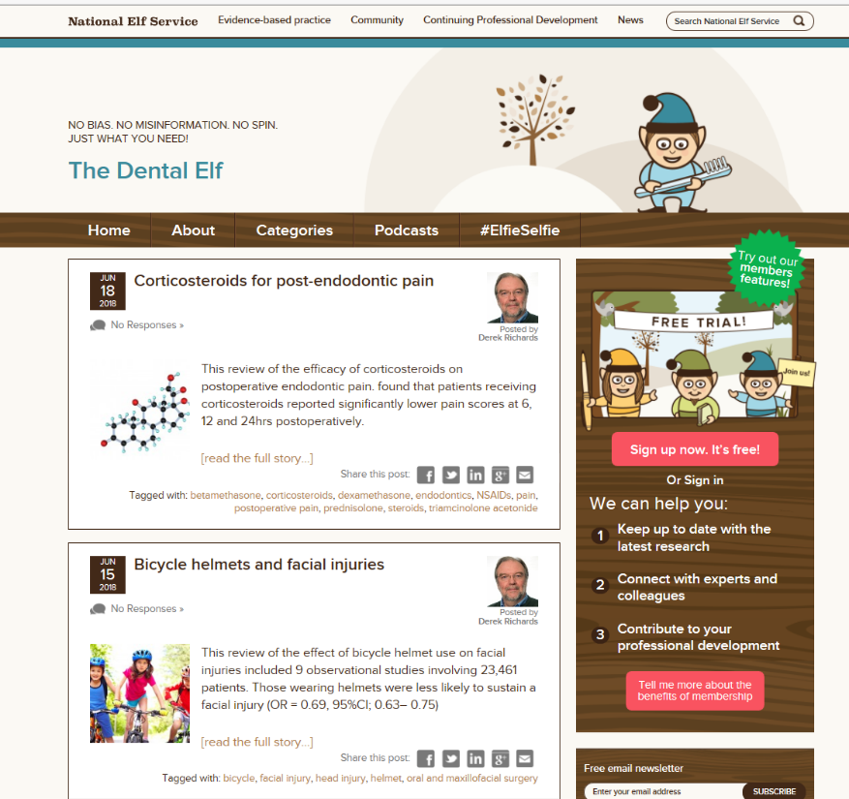
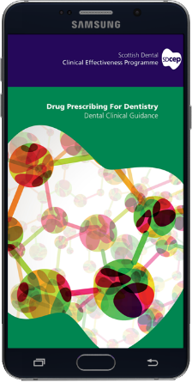
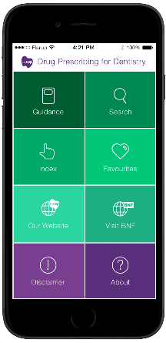




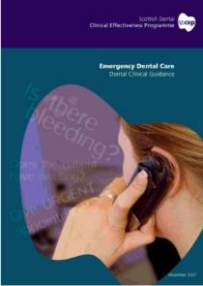


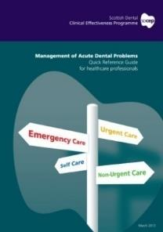







There is some help...

Slide 7













Knowledge into action cycle
Assess Behaviours
Knowledge Creation
Publication
Implementation
Cochrane
Diagnostic
Knowledge Transfer
and Implementation
Evaluation
Adapted from Graham et al (2006). Lost in Knowledge Translation. Time for a Map? Journal of Continuing Education for Health Professionals

Slide 8
Critical Appraisal
How can you tell whether a piece of research has been done properly and that the information it reports is reliable and trustworthy?
Critical appraisal is the process of carefully assessing and interpreting evidence through the systematic consideration of its validity, relevance and results
  i.e. what are the study’s strengths and weaknesses and can it be used to inform your practice?

Slide 9
Research articles
Summary of paper
(Abstracts can contain omissions or inaccuracies)
Review of literature. Is there are gap in current knowledge? What’s the aim of the study?
Is the paper worth reading?
What does the paper tell you?
What are the implications for your practice?
What else is of interest?
Abstract
Introduction
Methods
Results
Discussion

Slide 10
Issues to consider
Is the study design appropriate?
How well was the study conducted?
What are the results?
Are the results relevant to your clinical practice?

Slide 11
Study design
Study design can be observational or experimental:
Observational | Experimental
Case reports | Intervention study
Case series | Clinical trials
Cross-sectional surveys
Case control
Cohort

Slide 12

Evidence hierarchy
Cochrane Review
Review
(systematic)
Randomised
controlled trials
Cohort studies
Case-control studies
Case series, case reports
Editorials, expert opinion

Slide 13
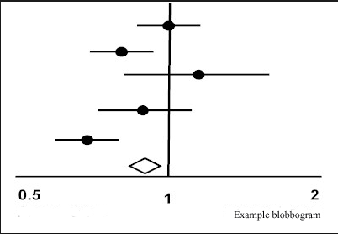
Forest plots
Line of no treatment effect intersects CI
Mean effect - OR
Confidence interval
Pooled point estimate plus confidence intervals
ODDS RATIO
Notes:
In a typical forest plot, the results of component studies are shown as blobs or squares centred on the point estimate
of the result of each study. A horizontal line runs through the square to show its confidence interval—
usually, but not always, a 95% confidence interval. The overall estimate from the meta­analysis and its confidence interval
are put at the bottom, represented as a diamond. The centre of the diamond represents the pooled point estimate, and its
horizontal tips represent the confidence interval. Significance is achieved at the set level if the diamond is clear of the
line of no effect.

Slide 14
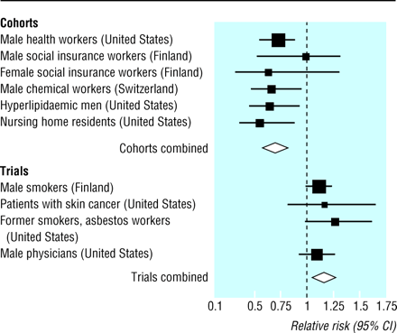
Why do an RCT?
Observational studies (cohorts) have consistently shown that people who eat more fruit and vegetables , which are rich in B carotene have lower rates of cardiovascular disease and cancer.
However, experimental studies (trials) to investigate the association between beta carotene intake and cardiovascular mortality tell a different story…
Notes:
Effect of

Slide 15
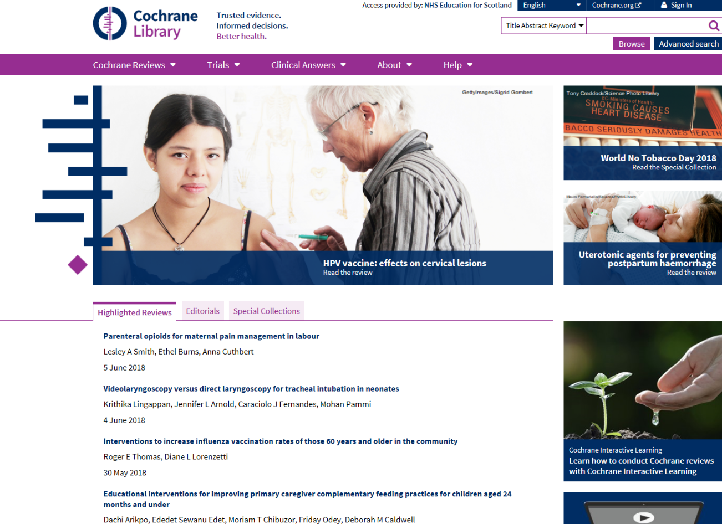

Slide 16

Cochrane Collaboration
Founded in 1993
International, non-profit making, independent
Vision:
Help clinicians, researchers, purchasers, and patients worldwide make decisions about healthcare based on up-to-date, reliable and accurate information

Slide 17
However...
A good observational study beats a poorly conducted RCT
Most appropriate design varies by the question:
  Interventions - RCT
  Prognosis/harm - cohort
  Rare disease – case control

Slide 18
What study design?
  To evaluate how effective paracetamol is at relieving pain?
  To evaluate a new filling material?
  To examine prognosis for individuals with pocketing >6 mm?
  To examine if smoking increases the risk of oral cancer?
  RCT
  RCT/Cohort
  Cohort
  Case control/cohort
  RCT may not always be the most appropriate design

Slide 19
Study Quality
How well was the study conducted?
Has bias been minimised?
Sources of bias:
  Selection - comparability of groups
  Performance - care provided to each group
  Measurement - outcome assessment
  Attrition - dropouts/withdrawals

Slide 20
Selection bias
Were the participants truly representative of the population?
What were the inclusion/exclusion criteria?
How were the participants recruited?
Were there systematic differences between comparison groups?

Slide 21
Selection bias
How can it be ensured that each individual entered into the trial has the same chance of receiving each of the possible interventions?
Randomisation ensures that the known and unknown confounding factors are equal in both groups
  Good: computer generated off-site allocation.
  Poor: coin-flip

Slide 22
How well was the study conducted?
Were there systematic differences in care provided to participants in a study (performance bias)?
Are all important outcomes considered?
Are there systematic differences in how outcomes are measured for the groups being compared (measurement bias)?
Are there systematic differences between treatment groups with regard to withdrawals or exclusions (attrition bias)?

Slide 23
Minimising bias
Blinding can reduce performance bias/ measurement bias
  Study leads can’t influence who gets the intervention
  Patients don’t know what treatment they have been given (BEWARE placebo effect)
  Outcome assessors don’t know who received the intervention so outcomes cannot be influenced
  Not always possible (e.g. surgery vs. drug)
Intention to treat analysis can reduce attrition bias

Slide 24
Intention to treat
Assessment is based on the group participants were initially allocated to.
Often used to assess clinical effectiveness rather than efficacy as it mirrors actual practice e.g. in real life not everyone adheres to treatments if there are side effects
Other statistical methods can be used to take missing data into account

Slide 25
Other issues
Sample size – was the study big enough?
Duration of follow-up
Were methods of assessment reasonable?
Are results presented for all outcomes?
Do the numbers add up?
Are the results statistically significant
  (P<0.05, 95% confidence interval)?
If so, are they clinically important?

Slide 26
Which would you choose?
Treatment reduces the risk of having decay by about 62%
Treatment reduced the odds of having decay by about 83%
Treatment produces an absolute reduction in risk of decay of 42%

Slide 27
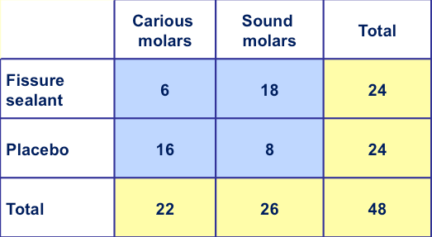
2x2 tables
Hypothetical trial of fissure sealant
on permanent molars
Risk reduction (-62%)
Risk 1 = 6/24 = 0.25
Risk 2 = 16/24 = 0.667
0.667 – 0.25 = 0.417
0.417/0.667 = 0.625
Odds reduction (-83%)
Odds 1 = 6/18 = 0.333
Odds 2 = 16/8 = 2
2 – 0.333 = 1.667
1.667/2 =0.8335
Absolute risk (-42%)
Risk 1 = 6/24 = 0.25
Risk 2 = 16/24 = 0.667
0.667 – 0.25 = 0.417

Slide 28
Are the results relevant to your clinical practice?
Not all valid research is relevant
How generalisable are the findings?
Is it feasible to implement the findings?
Use PICO to determine if the study is relevant to answer your question
  P(atient)I(ntervention)C(omparison)O(outcome)

Slide 29
In general...
Experimental studies are less susceptible to bias than observational studies
Prospective studies are less susceptible to bias than retrospective studies
Controlled studies are less susceptible to bias than uncontrolled studies
All studies need careful appraisal
Be cynical!

Slide 30
Tools
Checklists
www.sign.ac.uk/methodology/checklists
  available for all study types
  includes helpful notes explaining factors to consider whilst appraising the study
GRADE (www.gradeworkinggroup.org)
  ‘a common, sensible and transparent approach to grading quality of evidence and strength of recommendations’

Slide 31
RCT checklist
Does the study address an appropriate and clearly focused question?
Is the assignment of subjects to treatment groups randomised?
Is an adequate concealment method used?
Are subjects and investigators kept ‘blind’ to treatment allocation?
Were the treatment and control groups similar at the start of the trial?

Slide 32
RCT checklist
Is the only difference between the groups the treatment under investigation?
Are all relevant outcomes measured in a standard, valid and reliable way?
Are drop-outs reported and analysed appropriately?
Are all the subjects analysed in the groups to which they were randomly allocated (intention to treat analysis)?

Slide 33
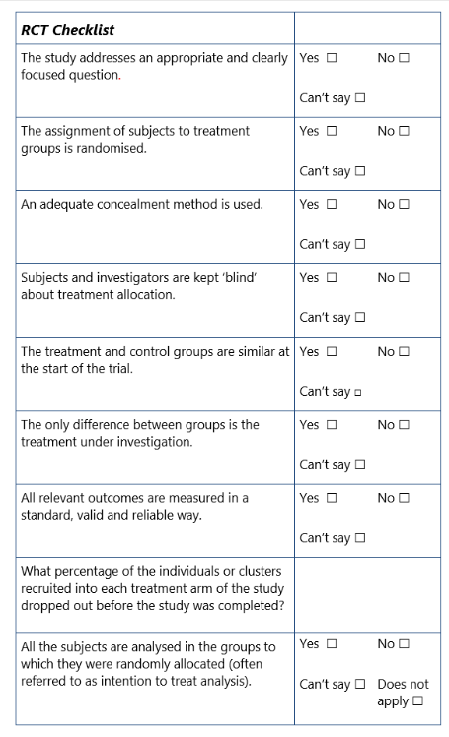
RCT checklist
The more ‘Yes’ answers,
the more likely that the
study is good quality
and can be trusted
BUT
not all questions are
of equal ‘weight’

Slide 34
Things to consider
How well was the study done to minimise the risk of bias or confounding?
Taking into account clinical considerations, your evaluation of the methodology used, and the statistical power of the study, are you certain that the overall effect is due to the study intervention?
Are the results of this study directly applicable to your patients?

Slide 35
Thank you
Questions?

